Slide 1
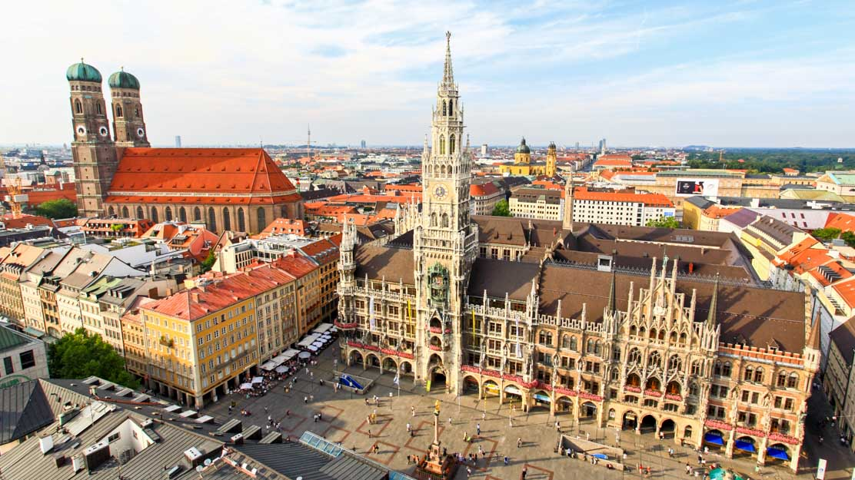
Opening up new gym in Munich
Own Capstone Project
(as part of IBM Applied Data Science with Python course)

Slide 2
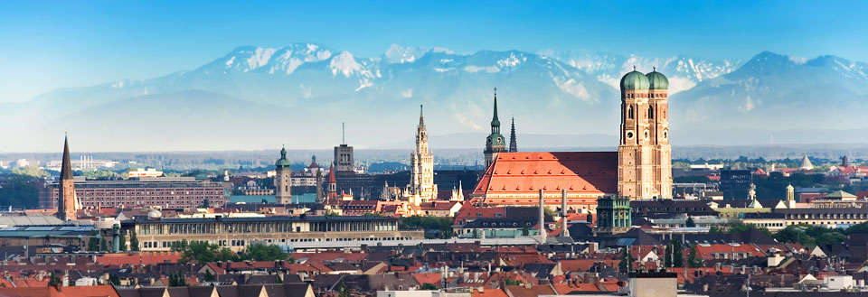
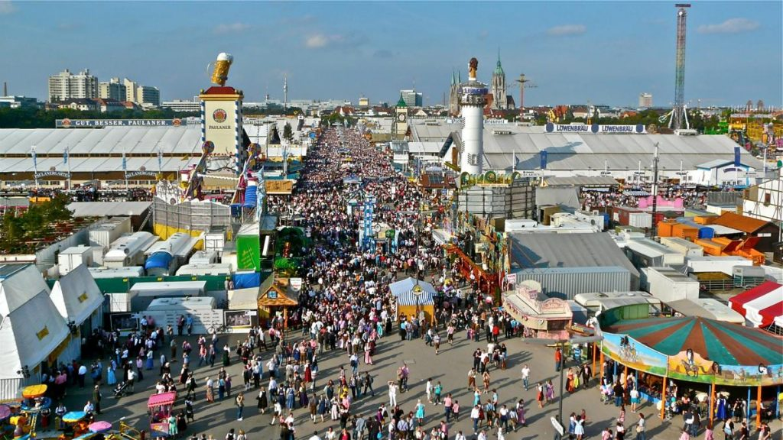
How about Munich?
Munich (München) - 3rd largest city in Germany (1.5 mil inhabitants) and growing fast
Located at the south of Germany in the province of Bavaria close to the Alps mountains
Famous for its beer festival Oktoberfest
Economicaly strongest city in Germany – large business potential

Slide 3
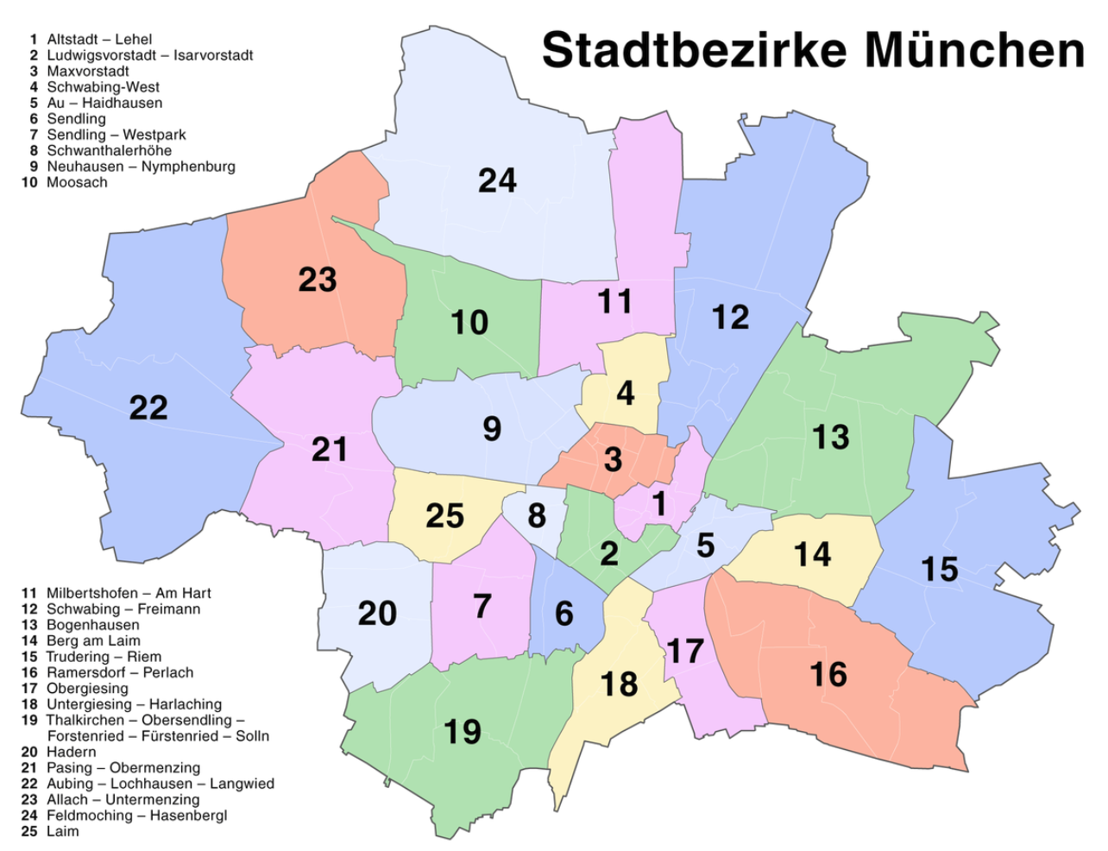
Project Introduction
Purpose of this project is to find neighbhorhoods with a space for a new gym venue
Munich has 25 neighborhoods (Stadtbezirke) that vary in size and wealthiness
Comparison of neighborhoods
number of gyms vs population
Affluence – average rent per sqm of private estates
Goal:
find the neighborhoods with high population and low number of gyms
what kind of gym to offer (simple vs luxurious)

Slide 4
Data Collection and Source
3 data inputs:
Foursquare API
List of gyms and their addresses
Format: json file
Demographical data
number of inhabitants in each neighborhood
source: Munich city council statistical website
Format: MS Excel file
Private property rent prices
Average rent per sqm in each neighborhood
Source: https://suedbayerische-immobilien.de/Mietpreise-Muenchen-Stadtteile
Format: table on the webpage

Slide 5
Methodology
Foursquare API – venue info
Collected number of gyms in each area and their addresses
Radius set high to cover large neighborhoods -> duplicated venues, filtered unique venues and checked the correcsponding venues using Geopy Nominatim library
Demographic file
Selected population 15 – 65 years old (customer base)
Calculated population share for additional gym in each area – „Potential Customers“
Rental price data
Table extracted from website using Beautiful Soup, applied name conversion
Merged all three columns into one dataframe

Slide 6
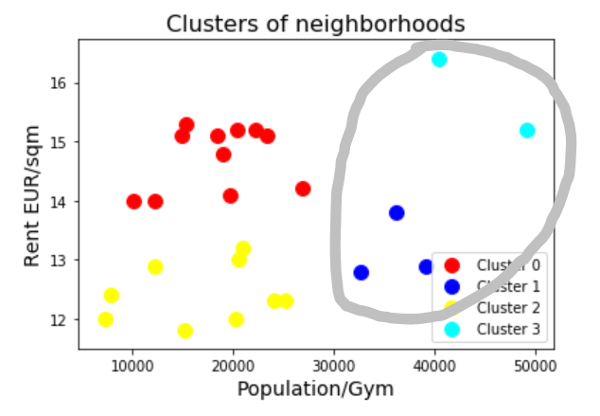
K-Means Clustering
Final data frame segmented into 4 clusters using K-Means algorithm
Inputs - population per gym and the average rent in each neighborhood
Clusters plotted into scatter plot
Clusters 1 and 3 – our target
neighborhoods with large population and no gyms
ranging over a variety of rent prices – cheaper as well as affluent areas

Slide 7
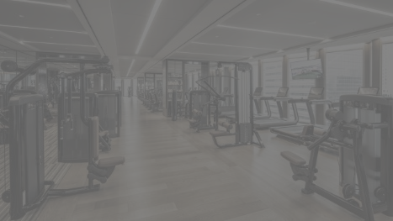
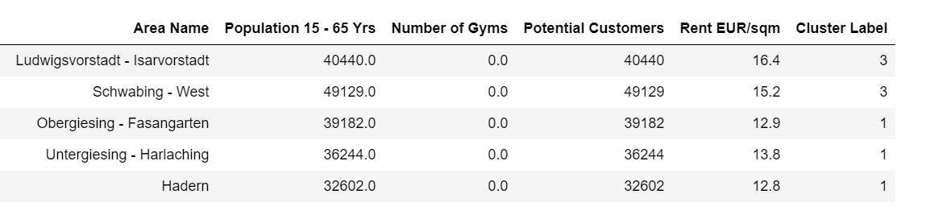
Optimal Neighborhoods for New Gym
Cluster 1 - medium to lower rent areas, welcome simple gym with average membership fees
Obergiesing – Fasangarten
Untergiesing – Harlaching
Hadern
Cluster 3 – high rent areas offering upscale venues, ideal for luxury gym with a lot of additional facilites
Ludwigsvorstadt – Isarvorstadt
Schwabing - West

Slide 8
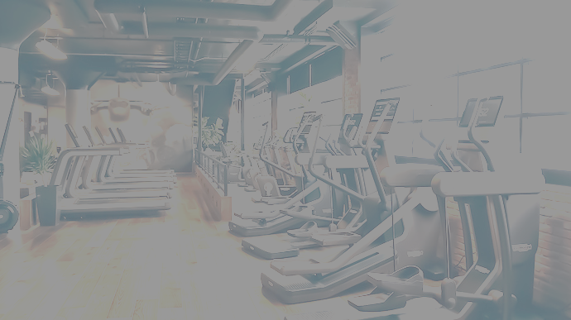
Thanks for your attention!

